Slide 1


Oral Communication Skills A
(CELEN069)
Core Unit 1
The transition from high school to university
Lesson 3.1

Slide 2
Lesson aims and objectives
By the end of this lesson, you should have enhanced your speaking and listening ability through practice.
In addition, you should be better able to … | Intended Learning Outcomes
recognise the overall structure of a lecture | 1.1-1.3 1.5 1.6 2.7 3.1 3.2 3.5
produce lecture notes that are organized into distinct sections
use information from a lecture to support ideas in a discussion

Slide 3

Getting started

Slide 4
Getting started
You have been a UNNC student now for 2 - 3 weeks. In that time, you have had many new experiences.
Look at the table on the right and consider your own answers for three of the emotions in the table.
Find a partner who is not in your group and interview them using the table. Try to get more information by asking questions to find out more detail.
Report back to your group. Try to identify any areas that have been mentioned in more than one interview. Be prepared to feedback to the class.
Something at UNNC that has made you feel…. | You | Your partner
happy
disappointed
interested
worried
excited
confused

Slide 5

Getting started
For homework, you recorded an interview with someone discussing the following question:
What are the three biggest differences between high school and university?
Work as a group. Listen to one interview on Teams using your headphones. It can be any interview (except your own), but each group member must choose a different one.
As you listen, note down the three differences.
When you have finished, share your information with your group. Then, work together to decide on the three biggest differences, justifying your answer.

Slide 6

Preparing for the lecture

Slide 7
Preparing for the lecture: Vocabulary building (A)
Check your answers to the homework task.
1. | This topic is relevant to many people’s lives. | d
2. | The transition from high school to university is challenging. | f
3. | At university there is more unstructured time than in high school. | a
4. | Children should be supervised when they are swimming. | h
5. | Safety training is mandatory for all new staff. | b
6. | Not studying hard is likely to have consequences in terms of low grades. | e
7. | Students who are active in classes get better results than passive students. | c
8. | I did a lot of research in the library before I wrote the assignment. | j
9. | Her latest study was published in a respected medical journal. | g
10. | There is strong evidence to support the scientist’s claim. | i
a | not organised or planned
b | an action or procedure that must be completed because it is a rule or law
c | accepting what happens without taking action
d | important or significant in a situation or to a person
e | the outcomes or results of an action, usually negative
f | the process of changing from one state to another state
g | an academic magazine for a specialised subject
h | monitored or observed to make sure of appropriate behaviour or correct action
i | facts or information indicating that something is true
j | work that involves studying something to find information about it

Slide 8
Preparing for the lecture: Vocabulary building (B)
Check your answers to the homework task.
The words could be:
words from the last task
different forms of words from the last task
words that collocate (naturally go together) with words from the last task
Words from the last task
1. | relevant
2. | transition
3. | unstructured
4. | supervised
5. | mandatory
6. | consequences
7. | passive
8. | research
9. | journal
10. | evidence
e.g. TESOL Quarterly is an academic journal of language learning.
I can’t see the r__________ o_____ what you are saying.
There needs to be further r__________ i__________ the effects of the disease.
There will be close s__________ o_____ the students during the science experiment.
One of t_____ c__________ o_____ poor time management is low grades.
The case was dismissed because of a lack o_____ e__________.
The company is changing its structure, so it is in a t__________ p__________ now.
relevance of
research into
supervision of
the consequences of
of evidence.
transition period

Slide 9


Preparing for the lecture: Listening and note-taking focus
Understanding overall structure
A good presenter will break down a lecture into sections, with these sections organized in a logical and coherent way. This helps the listener to organize the new information in their mind and in their notes. To understand the content of the lecture, it is first important to understand how the sections are organized. This structure is usually given in the outline section of the introduction and is often restated at the end in the conclusion.
Listen to the introduction of an academic lecture and note down the main topic and the different sections.
Then, listen to the conclusion to check whether you were right.
Main topic: | Practical considerations of studying abroad
Section 1: | Finding a suitable course
Section 2: | Academic aspects
Section 3: | Cultural challenges

Slide 10

Listening to the lecture

Slide 11

Listening to the lecture: Lecture content focus
You are going to watch Lecture 1A ‘Common issues faced by students’. The lecturer will discuss three areas students can find challenging when transitioning from high school to university. These areas relate to:
time
teachers
assignments
In your group, try to predict what the lecturer will say about each one.

Slide 12
Listening to the lecture: Listening
Watch Lecture 1A ‘Common issues faced by students’ and take notes as you listen.

Slide 13
Listening to the lecture: Comprehension check - Main ideas
Use your notes to decide the order that the ideas below were mentioned in the lecture (1-6).
a. A university schedule is less structured than a high school one. | 1
b. Academic assignments may be long and require stage by stage planning. | 5
c. Academic tasks require engagement in research. | 6
d. Chinese high school teachers work under a culture of respect and obedience. | 3
e. It is challenging to prioritise between study and other activities. | 2
f. Western university tutors expect students to have opinions and to express ideas. | 4

Slide 14
Listening to the lecture: Comprehension check - Details
Use your notes to correct the statements below.
1. University students in the UK don’t have mandatory classes.
University students in the UK have fewer mandatory classes per week than Chinese high school students.
2. Students may not allocate enough time to non-study activities, such as clubs and societies.
Students may allocate too much time to non-study activities, such as clubs and societies.
3. During high school, students may not be willing to ask questions because they are not interested in the subjects.
During high school, students may not be willing to ask questions because that may challenge the teacher’s authority.
4. At Western universities, asking questions shows that the students don’t understand the subject.
At Western universities, asking questions shows that the students are engaging with the subject.
5. Academic assignments may require reading some short texts on the internet.
Academic assignments require extensive reading of complex sources, such as journal articles.
6. Students are expected to adopt the opinions given in academic journals.
Students are expected to give their own opinions and support them with research.

Slide 15
Listening to the lecture: Listening reflection
Note-taking: Main ideas
At university, note-taking is an important skill. You may look at your notes again weeks or even months later to help you review a lecture’s key ideas, possibly for an exam or an assessed assignment.
In your notes, it is important that the main ideas stand out so that they are distinct from the detail. This will help you understand the overall structure more easily when you review them.
Look at your notes. Is it easy to differentiate between main ideas and detail?
How could you make the main ideas stand out more?

Slide 16
Listening to the lecture: Listening reflection
Look at a section of sample notes from today’s lecture.
Talk to your partner. Identify four ways the heading for the section is made clear.
Challenge to organize time: Some sts: too much time playing video games, join too many societies Study is most important → balance needed 2. Relationship with teachers Ch. high school teachers: Sts trust them & recognise superiority Sts maybe unwilling to express themselves or ask Qs (2008 study)
Use of numbers
Use of space
Use of bold/ underline/ colour
Indentation of details
Self-study: Do you think you need to develop the organisation and content of your notes after class?
Developing your notes after seminars and lectures is a great way of reviewing content and ensuring you have usable notes.

Slide 17

Developing the topic

Slide 18
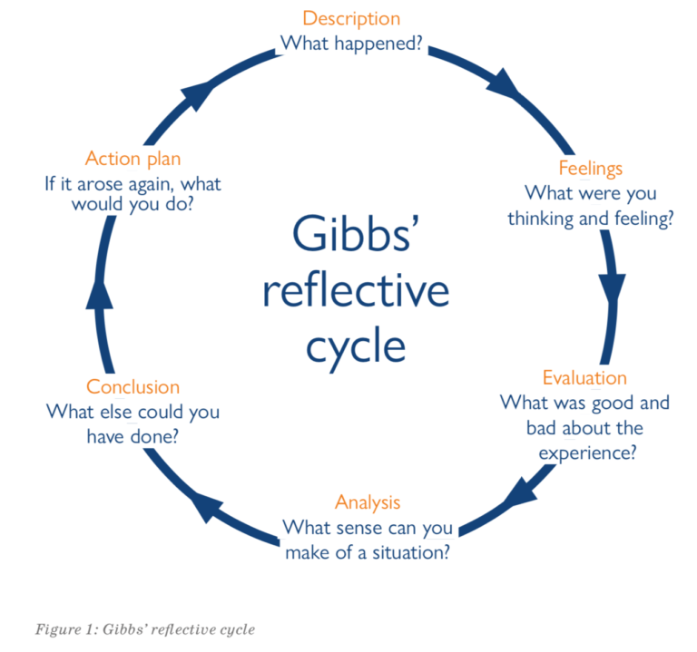
Developing the topic
In Live Lecture 1 you were introduced to Gibbs’ Reflective Cycle.
With a partner, use the model to reflect on an experience you have had so far at UNNC. It could relate to:
Your time management
Interactions with teachers
An assignment you are working on
Note:
- You don’t need to write the reflection, you can just talk.
- Try to use ideas from today’s lecture at the Analysis stage.

Slide 19
Homework
Due | Task
Lesson 3.2 | Watch the YouTube video ‘Study tips for college’ and write down the main tips. You can find the link to the video on the OCSa Moodle page, in the Week 3 section. N.B. You should be connected to eduroam wifi to watch the video.
Friday, 18th October 3pm | Listening Portfolio - Practice Task (unassessed) Watch Lecture 1B: Strategies for overcoming common issues and take notes. Submit a copy of your notes via the submission box on the OCSa Moodle page before the Friday deadline (file type accepted: .pdf ONLY)
Self-study
Watch today’s lecture again and develop your notes.

Slide 20
Oral Communication Skills A
(CELEN069)
Lesson 3.2

Slide 21
Lesson aims and objectives
By the end of this lesson, you should have enhanced your speaking and listening ability through practice.
In addition, you should be better able to … | Intended Learning Outcomes
demonstrate ability to give and support your own ideas, and invite other opinions | 1.1-1.6 2.2
produce accurate language to support your own ideas, and invite other opinions

Slide 22
Getting started

Slide 23


Getting started
If you had to use a single word or phrase to describe life at university, what would it be?
full of surprises
Take 1 minute to consider your answer. Think about why you chose that word/ phrase and think of an example.
Stand up and talk to two people who are not in your group. Give your opinion and support it with an explanation and an example. Then ask for their opinions. Use the language in the box.
a bit confusing
In my opinion, university life is __. Let me explain… I’ll give you an example… What do you think?

Slide 24
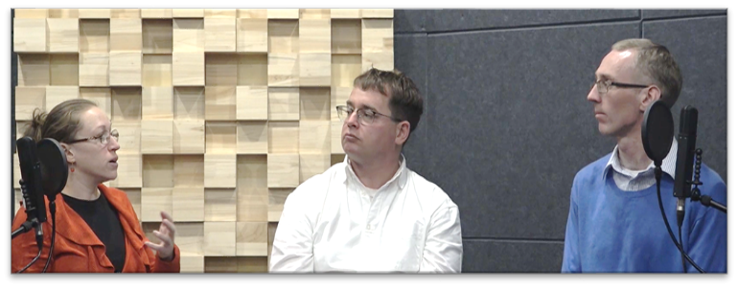
Getting started
Watch a short video of three speakers giving their own opinions on life at university.
As you watch, make notes on their opinions. Are their opinions similar or different from yours?
Michaela
John
Robert
Michaela | John | Robert
develop as an individual | exciting | stressful

Slide 25

Language and skills
focus

Slide 26
Language and skills focus: Giving, supporting & inviting other opinions
In academic speaking, it is very important to do the following:
Give your opinions and ideas.
Support your opinions and ideas with clear explanations, evidence from sources and/ or examples.
Ask for the opinions and ideas of others, so they can comment on the subject or on what you said.
e.g. In my opinion, university life is __. Let me explain… I’ll give you an example… What do you think?

Slide 27
Language and skills focus: Giving, supporting & inviting other opinions
Put the phrases from the first task into the table. Try to add at least one more phrase to each column.
For ‘Supporting opinions’ give a number according to the type of support .
(1) = explanations
(2) = evidence (i.e. data, facts, research findings)
(3) = examples (i.e. cases of real-world individuals/ specific groups, events, situations)
Giving opinions | Supporting opinions | Asking for opinions
In my opinion, … | Let me explain (1) | What do you think?
 | I’ll give you an example (3)
In my opinion, … Let me explain… I’ll give you an example… What do you think?

Slide 28
Language and skills focus: Giving, supporting & inviting other opinions
Watch the discussion video again and write down any phrases for giving/ supporting/ asking for opinions. Check with a partner and add all the phrases to the table.
Giving opinions | Supporting opinions | Asking for opinions
In my opinion, … | Let me explain (1) | What do you think?
 | I’ll give you an example (3)
(1) = explanations (2) = evidence (i.e. data, facts, research findings) (3) = examples (i.e. cases of real-world individuals/ specific groups, events, situations)

Slide 29
Language and skills focus: Giving, supporting & inviting other opinions
Giving opinions | Supporting opinions | Asking for opinions
In my opinion, … | Let me explain (1) | What do you think?
My take on this is | I’ll give you an example (3) | What do you think about this topic?
From my point of view | The reason I say this is (1) | What’s your opinion?
As far as I’m concerned | A specific example of … is (3)
 | According to a study (2)
 | What do I mean by this? (1)
 | I’ve read somewhere (2)
 | For example (3)
(1) = explanations
(2) = evidence (i.e. data, facts, research findings)
(3) = examples (i.e. cases of real-world individuals/ specific groups, events, situations)

Slide 30
Discussion focus

Slide 31
Discussion focus: Prepare
For homework you were asked to watch a YouTube video giving study tips.
You may have also already watched Lecture 1B.
As a group, make a list of the different pieces of advice you heard in the video(s).
Then, each group member should choose one piece of advice that they thought was particularly useful.
Explain your choice to the group by first giving your opinion and then supporting it. Finally, ask for another opinion. Try to use some of the language from the previous tasks.

Slide 32

Discussion focus: Discuss
In small groups, have a discussion based on the prompt below.
Make sure that you use all the time and that everybody has a chance to give and support their opinions.
What are some of the main challenges a new university student faces?
What are the best ways of dealing with those challenges?

Slide 33
Discussion focus: Reflect
Reflect on your group discussion and answer the questions below.
 |  | Yes | Partly | No
My group | We used all the time
 | We answered the questions on the prompt
 | All the content was relevant
 | Everybody had a chance to contribute
Me | I gave my opinion in both parts of the task
 | I supported my opinions
 | I asked others for their opinions
1 or 2 things I did well…
1 or 2 things I could do better in the next discussion…

Slide 34

Homework
Due | Task
Friday, 18th October 3pm | Listening Portfolio - Practice Task (unassessed) Watch Lecture 1B: Strategies for overcoming common issues and take notes. Submit a copy of your notes via the submission box on the OCSa Moodle page before the Sunday deadline (file type accepted: .pdf ONLY)
Lesson 4.1 | Visit the ‘UNNC Health and Wellbeing Centre’ web page. Consider the questions below. https://www.nottingham.edu.cn/en/health-and-wellbeing-centre/home.aspx How do the services available contribute to the university’s EDI principles? How can we encourage students to use these services when they need them? Complete ‘Vocabulary building’ tasks A & B (Class Workbook - Lesson 4.1).
Self-study
Check out the self-study materials on the OCSa Moodle page for this week: vocab review, reading more on the topic, additional listening practice.

